Slide 1
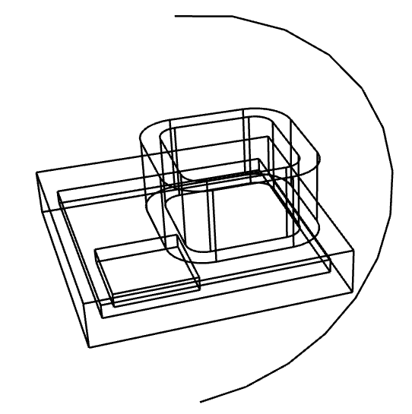
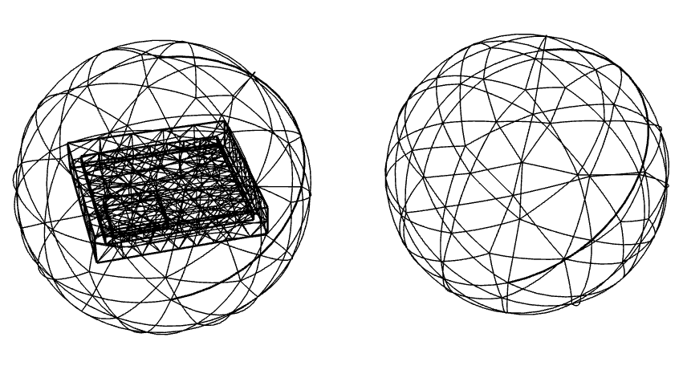
TEAM W.S. Problem 7

Slide 2
TEAM W.S. Problem 7
A-φ-Ar法による渦電流解析
Hierarchic 三次有限要素法解析
Kelvin変換による開領域解析
Adaptive Meshing

Slide 3
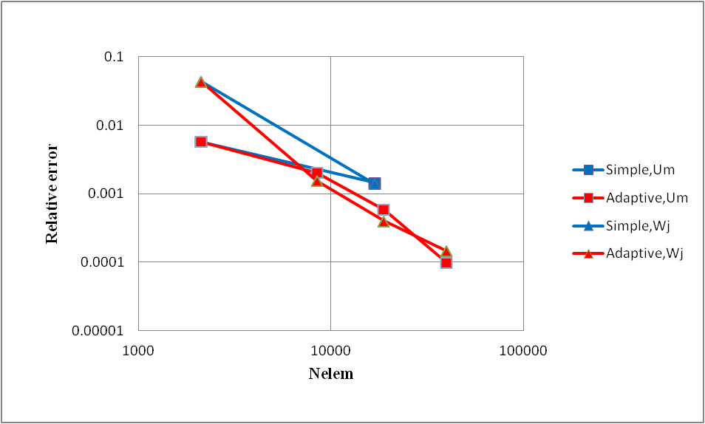
Mesh refinement

Slide 4
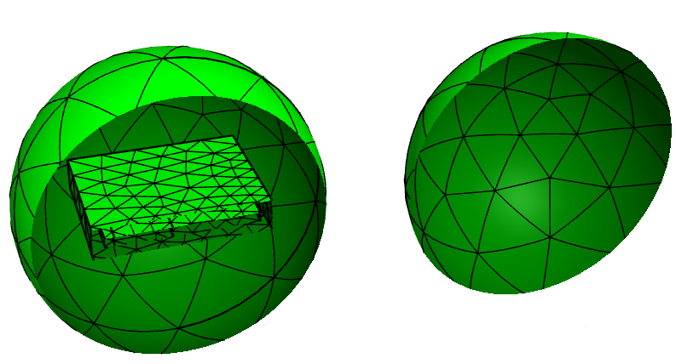
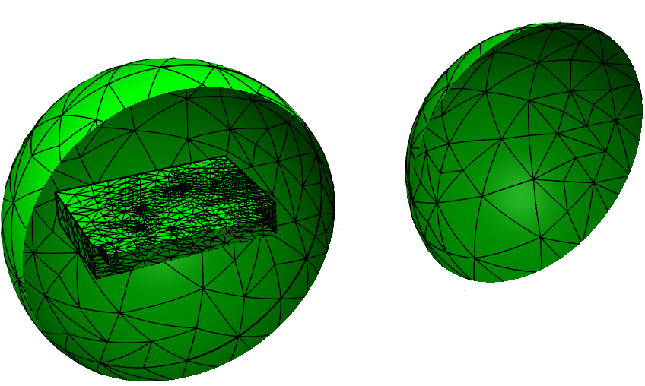
ne= 2116
ne= 39968

Slide 5
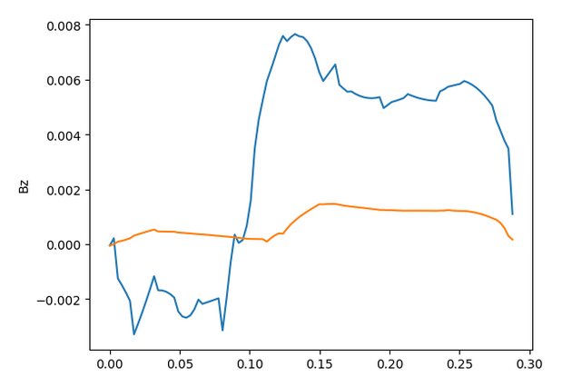
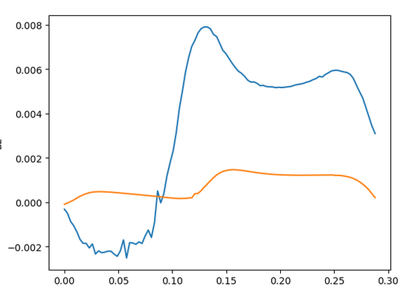
ne= 2116
ne= 39968

Slide 6
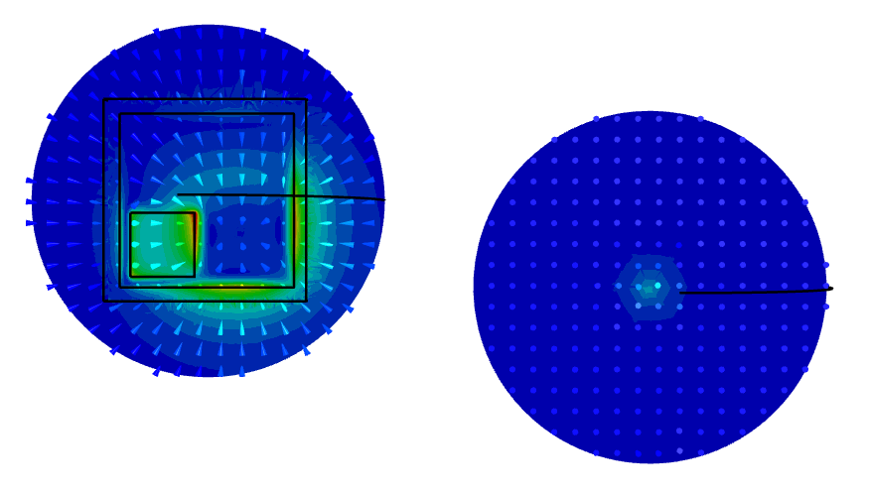
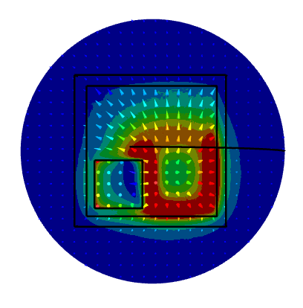
Magnetic Field
at plate center
Kelvin external region
Real part
Imaginary part

Slide 7
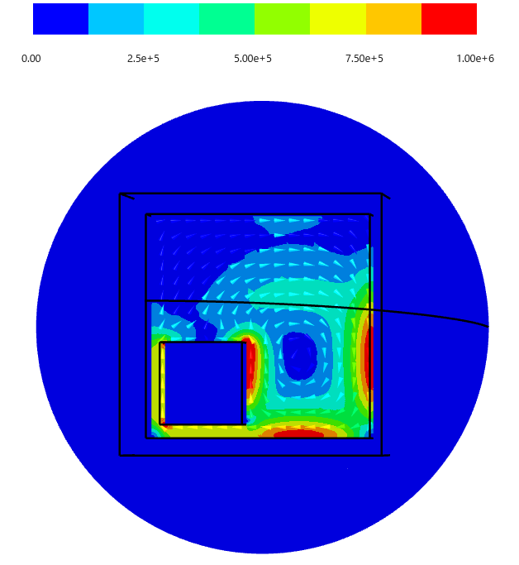
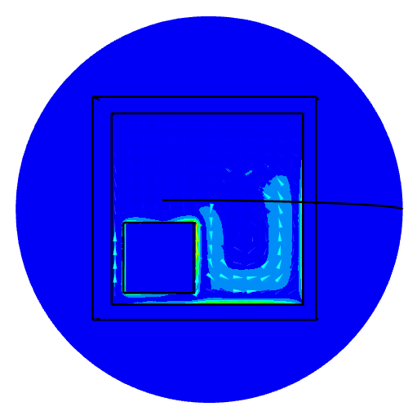
Eddy current
at plate center
Real part
Imaginary part

